Slide 1
12”H.265 1080P
Full HD wireless camera system
Okay Intelligent Technology

Slide 2
12”H.265 1080P Full HD wireless camera system
Features：
● 12＂LCD Panel Resolution1920×1080（Full HD）
● H.265 compression
● 4CH realtime Full HD 1080P Recording & Playback
● Built-in 2.5” HDD slot (support 8TB max.)
● Support P2P Smartphone & PC/Remote Web View
● Wireless Range up to 150 Meters(Open area)
● Support multi-language, more than 14 languages
Notes:
模板来自于 http://meihua.docer.com/

Slide 3
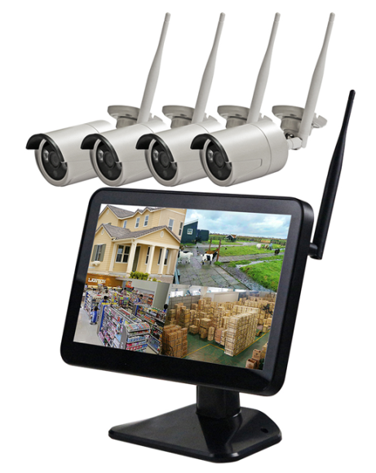
12”H.265 1080P Full HD wireless camera system
Model: KW1218N4
Recording Modes:
Manual, Scheduled, Motion Trigger
Network Apps: MYEYE / XMEYE
Color: black monitor + white camera
Selling point:
12”Full HD 1920*1080, clear and beautiful image
No need wired connection, simpler and cheaper for installation than wired system
Easy to operate, very convenient interface
Support P2P Smartphone & PC / Remote Web View
Notes:
模板来自于 http://meihua.docer.com/

Slide 4
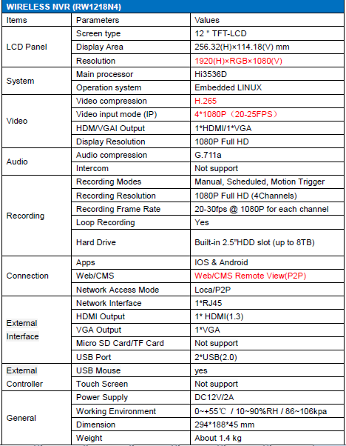
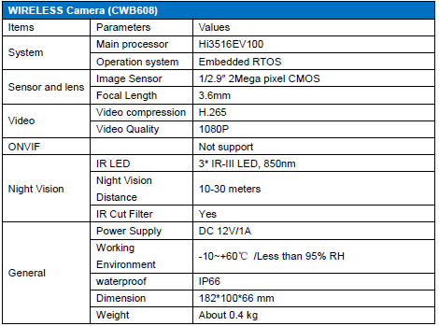
Specification

Slide 5
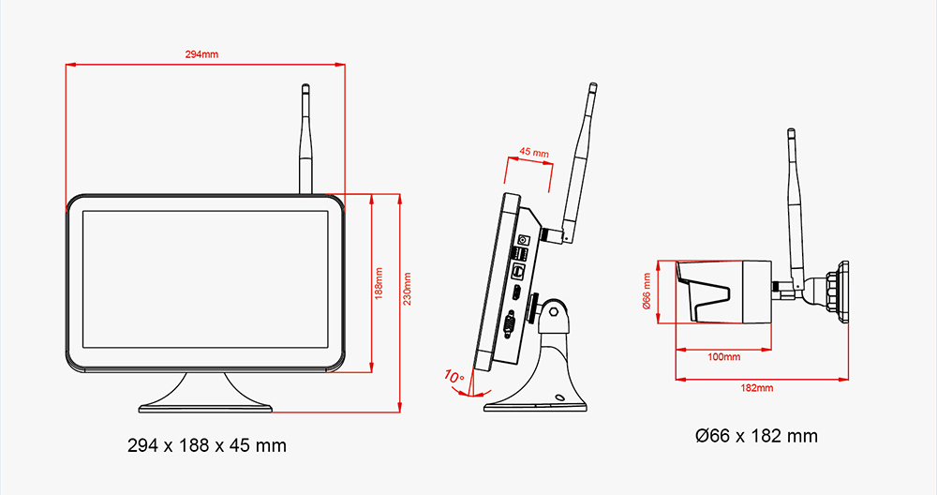
Size of monitor and camera

Slide 6
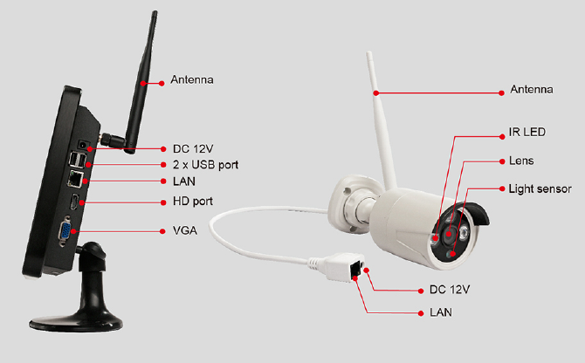
Diagram of monitor and camera

Slide 7
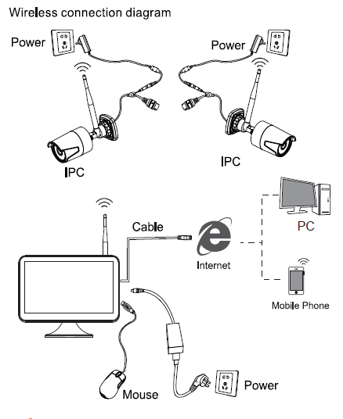
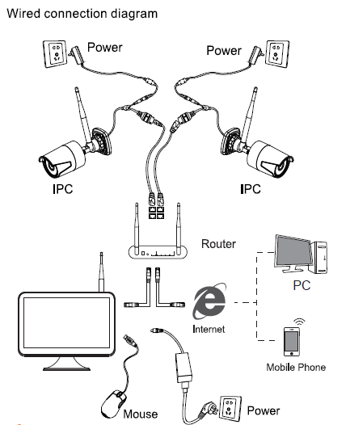
Two connection ways

Slide 8
Support Android and iOS system

Slide 9
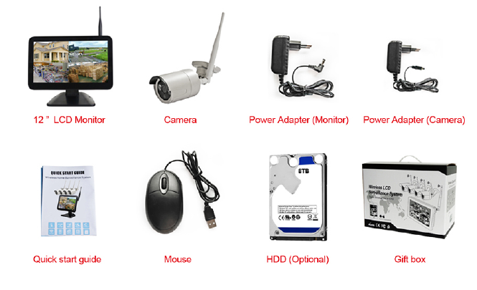
Package including

Slide 10
Why choose us
Why choose this system?

Slide 11
H.265 compression

Slide 12
Can be used like wired NVR kit
Notes:
模板来自于 http://meihua.docer.com/

Slide 13
Camera for outdoor use

Slide 14
Built-in Rechargeable battery in Bracket
Rechargeable battery in bracket (Optional):
Built-in Rechargeable Li-lion Battery in bracket for monitor
Using monitor without power adapter.
Can work 2-3hrs based on full rechargeable power

Slide 15
Application sites
Notes:
模板来自于 http://meihua.docer.com/

Slide 16
Thank You !
Buy it, do not falter

